Slide 1
8051 Addressing Modes & Instruction Set

Slide 2






































Slide 3







8051 Instruction Set
Addressing Modes
Register addressing
Direct addressing
Indirect addressing
Immediate constant addressing
Relative addressing
Absolute addressing
Long addressing
Indexed addressing
Instruction Types
Arithmetic operations
Logical operations
Data transfer instructions
Boolean variable instructions
Program branching instructions
Notes:
In this lecture we will look at the various addressing modes and the instructions.

Slide 4














Addressing Modes
Eight modes of addressing are available with the C8051F020
The different addressing modes determine how the operand byte is selected
Addressing Modes | Instruction
Register | MOV A, B
Direct | MOV 30H,A
Indirect | ADD A,@R0
Immediate Constant | ADD A,#80H
Relative* | SJMP AHEAD
Absolute* | AJMP BACK
Long* | LJMP FAR_AHEAD
Indexed | MOVC A,@A+PC
* Related to program branching instructions
Notes:
There are 8 addressing modes. The addressing mode determines how the operand byte is selected.

Slide 5







Register Addressing
The register addressing instruction involves information transfer between registers
Example:
MOV R0, A
The instruction transfers the accumulator content into the R0 register. The register bank (Bank 0, 1, 2 or 3) must be specified prior to this instruction.
Notes:
In the Register Addressing mode, the instruction involves transfer of information between registers.
The accumulator is referred to as the A register.

Slide 6






Direct Addressing
This mode allows you to specify the operand by giving its actual memory address (typically specified in hexadecimal format) or by giving its abbreviated name (e.g. P3)
Note: Abbreviated SFR names are defined in the “C8051F020.inc” header file
Example:
MOV A, P3 ;Transfer the contents of ;Port 3 to the accumulator
MOV A, 020H ;Transfer the contents of RAM ;location 20H to the accumulator
Notes:
In Direct Addressing mode you specify the operand by giving its actual memory address (in Hexadecimal) or by giving its abbreviated name (e.g. P3).

Slide 7




Indirect Addressing
This mode uses a pointer to hold the effective address of the operand
Only registers R0, R1 and DPTR can be used as the pointer registers
The R0 and R1 registers can hold an 8-bit address, whereas DPTR can hold a 16-bit address
Examples:
MOV @R0,A ;Store the content of ;accumulator into the memory ;location pointed to by ;register R0. R0 could have an ;8-bit address, such as 60H.
MOVX A,@DPTR ;Transfer the contents from ;the memory location ;pointed to by DPTR into the ;accumulator. DPTR could have a ;16-bit address, such as 1234H.
Notes:
In the Indirect Addressing mode, a register is used to hold the effective address of the operand. This register, which holds the address, is called the pointer register and is said to point to the operand.
Only registers R0, R1 and DPTR can be used as pointer registers.
R0 and R1 registers can hold an 8-bit address whereas DPTR can hold a 16-bit address. DPTR is useful in accessing operands which are in the external memory.

Slide 8







Immediate Constant Addressing
This mode of addressing uses either an 8- or 16-bit constant value as the source operand
This constant is specified in the instruction, rather than in a register or a memory location
The destination register should hold the same data size which is specified by the source operand
Examples:
ADD A,#030H ;Add 8-bit value of 30H to
;the accumulator register
;(which is an 8-bit register).
MOV DPTR,#0FE00H ;Move 16-bit data constant ;FE00H into the 16-bit Data ;Pointer Register.
Notes:
In the Immediate Constant Addressing mode, the source operand is an 8- or 16-bit constant value.
This constant is specified in the instruction itself (rather than in a register or a memory location).
The destination register should hold the same data size which is specified by the source operand.

Slide 9














Relative Addressing
This mode of addressing is used with some type of jump instructions, like SJMP (short jump) and conditional jumps like JNZ
These instructions transfer control from one part of a program to another
The destination address must be within -128 and +127 bytes from the current instruction address because an 8-bit offset is used (2⁸ = 256)
Example:
GoBack: DEC A ;Decrement A
JNZ GoBack ;If A is not zero, loop back
Notes:
The Relative Addressing mode is used with some type of jump instructions like SJMP (short jump) and conditional jumps like JNZ. This instruction transfers control from one part of a program to another.

Slide 10









Absolute Addressing
Two instructions associated with this mode of addressing are ACALL and AJMP instructions
These are 2-byte instructions where the 11-bit absolute address is specified as the operand
The upper 5 bits of the 16-bit PC address are not modified. The lower 11 bits are loaded from this instruction. So, the branch address must be within the current 2K byte page of program memory (2¹¹ = 2048)
Example:
ACALL PORT_INIT ;PORT_INIT should be ;located within 2k bytes.
PORT_INIT: MOV P0, #0FH ;PORT_INIT subroutine
Notes:
In Absolute Addressing mode, the absolute address, to which the control is transferred, is specified by a label. Two instructions associated with this mode of addressing are ACALL and AJMP instructions. These are 2-byte instructions.

Slide 11

Long Addressing
This mode of addressing is used with the LCALL and LJMP instructions
It is a 3-byte instruction and the last 2 bytes specify a 16-bit destination location where the program branches
It allows use of the full 64 K code space
The program will always branch to the same location no matter where the program was previously
Example:
LCALL TIMER_INIT ;TIMER_INIT address (16-bits ;long) is specified as the ;operand; In C, this will be a ;function call: Timer_Init().
TIMER_INIT: ORL TMOD,#01H ;TIMER_INIT subroutine
Notes:
This mode of addressing is used with the LCALL and LJMP instructions. It is a 3-byte instruction and the last 2 bytes specify a 16-bit destination location where the program branches to. It allows use of the full 64K code space.

Slide 12
Indexed Addressing
The Indexed addressing is useful when there is a need to retrieve data from a look-up table
A 16-bit register (data pointer) holds the base address and the accumulator holds an 8-bit displacement or index value
The sum of these two registers forms the effective address for a JMP or MOVC instruction
Example:
MOV A,#08H ;Offset from table start
MOV DPTR,#01F00H ;Table start address
MOVC A,@A+DPTR ;Gets target value from the table ;start address + offset and puts it ;in A.
After the execution of the above instructions, the program will branch to address 1F08H (1F00H+08H) and transfer into the accumulator the data byte retrieved from that location (from the look-up table)
Notes:
The Indexed addressing is useful when there is a need to retrieve data from a look-up table (LUT). A 16-bit register (data pointer) holds the base address and the accumulator holds an 8-bit displacement or index value. The sum of these two registers forms the effective address for a JMP or MOVC instruction.

Slide 13
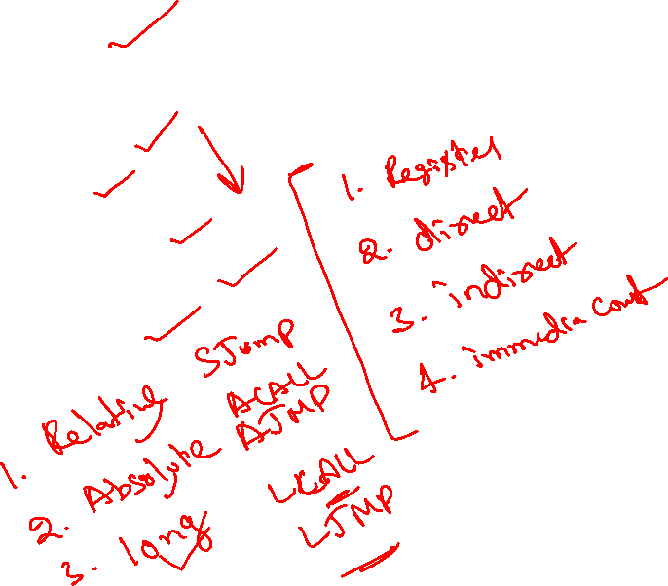
Instruction Types
The 8051 instructions are divided into five functional groups:
Arithmetic operations
Logical operations
Data transfer operations
Boolean variable operations
Program branching operations
Notes:
The 8051 instructions are divided into five functional groups. We will discuss each group separately.

Slide 14
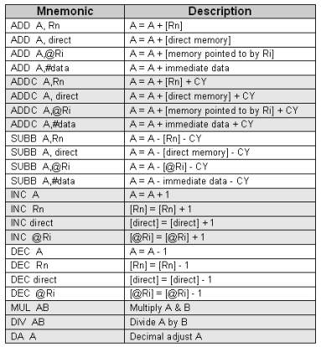
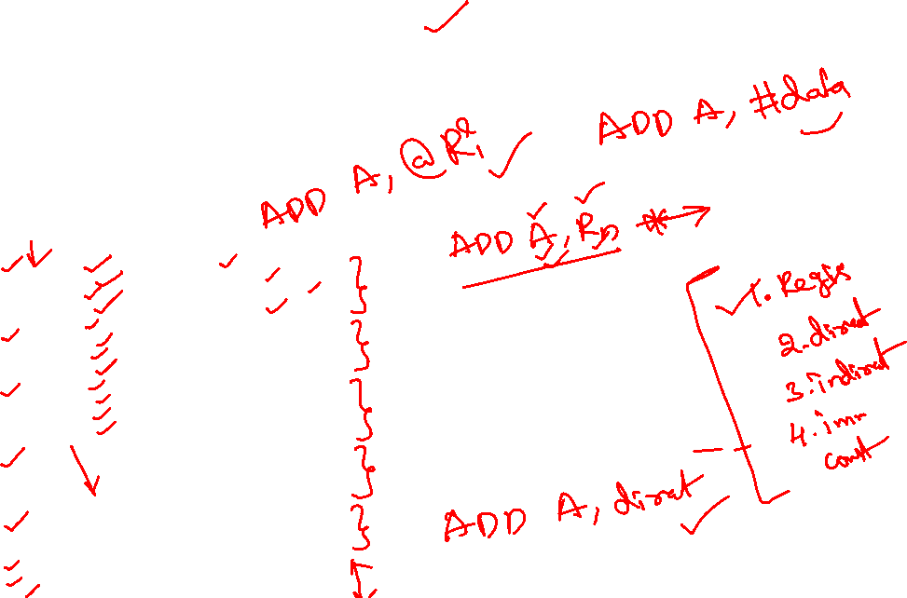
Arithmetic Operations
With arithmetic instructions, the 8051 has no special knowledge of the data format (e.g. signed binary, unsigned binary, binary coded decimal, ASCII, etc.)
The appropriate status bits in the PSW are set when specific conditions are met, which allows the user software to manage the different data formats
[@Ri] implies contents of memory location pointed to by R0 or R1
Rn refers to registers R0-R7 of the currently selected register bank
Notes:
This group of operators perform arithmetic operations. Arithmetic operations effect the flags, such as Carry Flag (CY), Overflow Flag (OV) etc, in the PSW register.

Slide 15
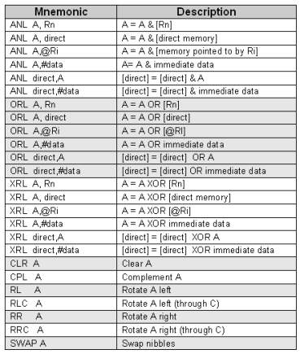
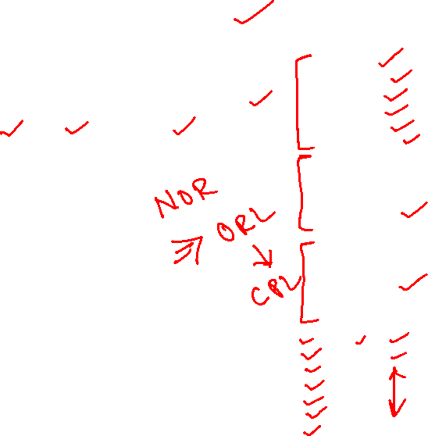
Logical Operations
Logical instructions perform Boolean operations (AND, OR, XOR, and NOT) on data bytes on a bit-by-bit basis
Examples:
ANL A, #02H ;Mask bit 1
ORL TCON, A ;TCON=TCON-OR-A
Notes:
Logical instructions perform standard Boolean operations such as AND, OR, XOR, NOT (compliment). Other logical operations are clear accumulator, rotate accumulator left and right, and swap nibbles in accumulator.

Slide 16
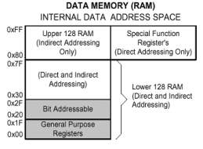

Data Transfer Instructions
Data transfer instructions can be used to transfer data between an internal RAM location and an SFR location without going through the accumulator
It is also possible to transfer data between the internal and external RAM by using indirect addressing
The upper 128 bytes of data RAM are accessed only by indirect addressing and the SFRs are accessed only by direct addressing
Mnemonic | Description
MOV @Ri, direct | [@Ri] = [direct]
MOV @Ri, #data | [@Ri] = immediate data
MOV DPTR, #data 16 | [DPTR] = immediate data
MOVC A,@A+DPTR | A = Code byte from [@A+DPTR]
MOVC A,@A+PC | A = Code byte from [@A+PC]
MOVX A,@Ri | A = Data byte from external ram [@Ri]
MOVX A,@DPTR | A = Data byte from external ram [@DPTR]
MOVX @Ri, A | External[@Ri] = A
MOVX @DPTR,A | External[@DPTR] = A
PUSH direct | Push into stack
POP direct | Pop from stack
XCH A,Rn | A = [Rn], [Rn] = A
XCH A, direct | A = [direct], [direct] = A
XCH A, @Ri | A = [@Rn], [@Rn] = A
XCHD A,@Ri | Exchange low order digits
Notes:
Data transfer instructions are used to transfer data between an internal RAM location and SFR location without going through the accumulator. Data can also be transferred between the internal and external RAM by using indirect addressing.

Slide 17
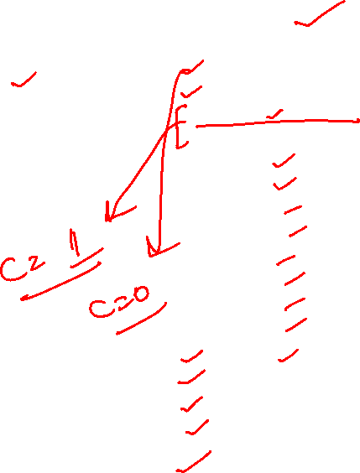
Boolean Variable Instructions
The 8051 processor can perform single bit operations
The operations include set, clear, and, or and complement instructions
Also included are bit–level moves or conditional jump instructions
All bit accesses use direct addressing
Examples:
SETB TR0 ;Start Timer0.
POLL: JNB TR0, POLL ;Wait till timer overflows.
Mnemonic | Description
CLR C | Clear C
CLR bit | Clear direct bit
SETB C | Set C
SETB bit | Set direct bit
CPL C | Complement c
CPL bit | Complement direct bit
ANL C,bit | AND bit with C
ANL C,/bit | AND NOT bit with C
ORL C,bit | OR bit with C
ORL C,/bit | OR NOT bit with C
MOV C,bit | MOV bit to C
MOV bit,C | MOV C to bit
JC rel | Jump if C set
JNC rel | Jump if C not set
JB bit,rel | Jump if specified bit set
JNB bit,rel | Jump if specified bit not set
JBC bit,rel | if specified bit set then clear it and jump
Notes:
The Boolean Variable operations include set, clear, as well as and, or and complement instructions. Also included are bit–level moves or conditional jump instructions. All bit accesses use direct addressing.

Slide 18

Program Branching Instructions
Mnemonic | Description
ACALL addr11 | Absolute subroutine call
LCALL addr16 | Long subroutine call
RET | Return from subroutine
RETI | Return from interrupt
AJMP addr11 | Absolute jump
LJMP addr16 | Long jump
SJMP rel | Short jump
JMP @A+DPTR | Jump indirect
JZ rel | Jump if A=0
JNZ rel | Jump if A NOT=0
CJNE A,direct,rel | Compare and Jump if Not Equal
CJNE A,#data,rel
CJNE Rn,#data,rel
CJNE @Ri,#data,rel
DJNZ Rn,rel | Decrement and Jump if Not Zero
DJNZ direct,rel
NOP | No Operation
Program branching instructions are used to control the flow of program execution
Some instructions provide decision making capabilities before transferring control to other parts of the program (conditional branches).
Notes:
Program branching instructions are used to control the flow of actions in a program. Some instructions provide decision making capabilities and transfer control to other parts of the program e.g. conditional and unconditional branches.

Slide 19
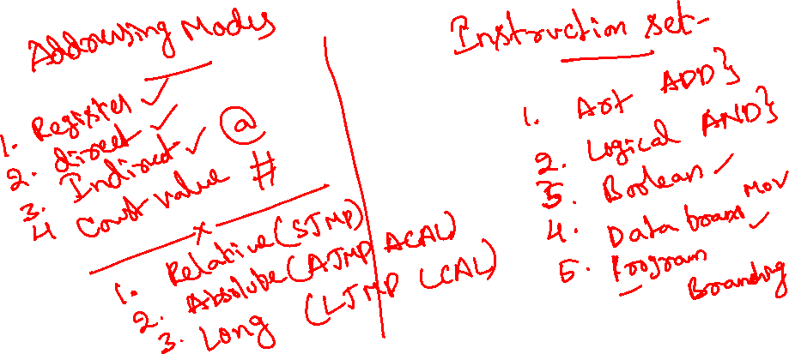
More Details On Each Instruction
8051 Instruction

Slide 20

Arithmetic Operations
[@Ri] implies contents of memory location pointed to by R0 or R1
Rn refers to registers R0-R7 of the currently selected register bank
Notes:
The arithmetic operations are – addition, subtraction, increment, decrement, multiplication and division. The operations use different addressing modes discussed earlier.

Slide 21
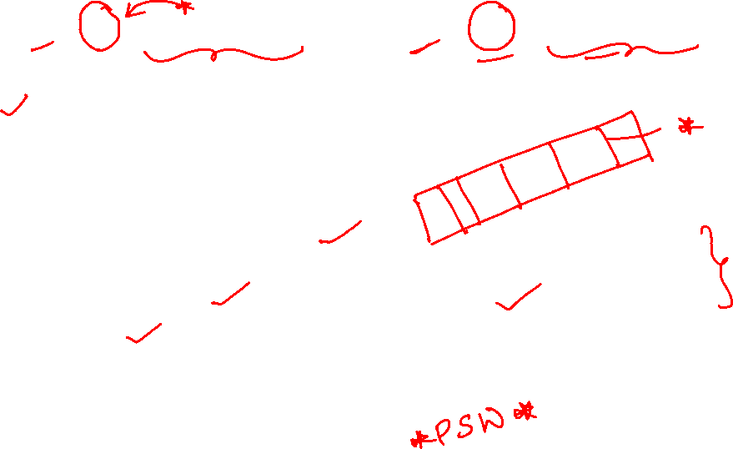
ADD A,<source-byte> ADDC A,<source-byte>
ADD adds the data byte specified by the source operand to the accumulator, leaving the result in the accumulator
ADDC adds the data byte specified by the source operand, the carry flag and the accumulator contents, leaving the result in the accumulator
Operation of both the instructions, ADD and ADDC, can affect the carry flag (CY), auxiliary carry flag (AC) and the overflow flag (OV)
CY=1 If there is a carryout from bit 7; cleared otherwise
AC =1 If there is a carryout from the lower 4-bit of A i.e. from bit 3; cleared otherwise
OV=1 If the signed result cannot be expressed within the number of bits in the destination operand; cleared otherwise

Slide 22

SUBB A,<source-byte>
SUBB subtracts the specified data byte and the carry flag together from the accumulator, leaving the result in the accumulator
CY=1 If a borrow is needed for bit 7; cleared otherwise
AC =1 If a borrow is needed for bit 3, cleared otherwise
OV=1 If a borrow is needed into bit 6, but not into bit 7, or into bit 7, but not into bit 6.
Example:
The accumulator holds 0C1H (11000001B), Register1 holds 40H (01000000B) and the CY=1.The instruction,
SUBB A, R1
gives the value 70H (01110000B) in the accumulator, with the CY=0 and AC=0 but OV=1

Slide 23

INC <byte>
Increments the data variable by 1. The instruction is used in register, direct or register direct addressing modes
Example:
INC 6FH
If the internal RAM location 6FH contains 30H, then the instruction increments this value, leaving 31H in location 6FH
Example:
MOV R1, #5E INC R1 INC @R1
If R1=5E (01011110) and internal RAM location 5FH contains 20H, the instructions will result in R1=5FH and internal RAM location 5FH to increment by one to 21H

Slide 24

DEC <byte>
The data variable is decremented by 1
The instruction is used in accumulator, register, direct or register direct addressing modes
A data of value 00H underflows to FFH after the operation
No flags are affected

Slide 25
INC DPTR
Increments the 16-bit data pointer by 1
DPTR is the only 16-bit register that can be incremented
The instruction adds one to the contents of DPTR directly

Slide 26

MUL AB
Multiplies A & B and the 16-bit result stored in [B15-8], [A7-0]
Multiplies the unsigned 8-bit integers in the accumulator and the B register
The Low order byte of the 16-bit product will go to the accumulator and the High order byte will go to the B register
If the product is greater than 255 (FFH), the overflow flag is set; otherwise it is cleared. The carry flag is always cleared.
If ACC=85 (55H) and B=23 (17H), the instruction gives the product 1955 (07A3H), so B is now 07H and the accumulator is A3H. The overflow flag is set and the carry flag is cleared.

Slide 27

DIV AB
Divides A by B
The integer part of the quotient is stored in A and the remainder goes to the B register
If ACC=90 (5AH) and B=05(05H), the instruction leaves 18 (12H) in ACC and the value 00 (00H) in B, since 90/5 = 18 (quotient) and 00 (remainder)
Carry and OV are both cleared
If B contains 00H before the division operation, then the values stored in ACC and B are undefined and an overflow flag is set. The carry flag is cleared.

Slide 28
DA A
This is a decimal adjust instruction
It adjusts the 8-bit value in ACC resulting from operations like ADD or ADDC and produces two 4-bit digits (in packed Binary Coded Decimal (BCD) format)
Effectively, this instruction performs the decimal conversion by adding 00H, 06H, 60H or 66H to the accumulator, depending on the initial value of ACC and PSW
If ACC bits A3-0 are greater than 9 (xxxx1010-xxxx1111), or if AC=1, then a value 6 is added to the accumulator to produce a correct BCD digit in the lower order nibble
If CY=1, because the high order bits A7-4 is now exceeding 9 (1010xxxx-1111xxxx), then these high order bits will be increased by 6 to produce a correct proper BCD in the high order nibble but not clear the carry

Slide 29
Logical Operations
Logical instructions perform Boolean operations (AND, OR, XOR, and NOT) on data bytes on a bit-by-bit basis
Notes:
Logical instructions perform standard Boolean operations such as AND, OR, XOR, NOT (compliment). Other logical operations are clear accumulator, rotate accumulator left and right, and swap nibbles in accumulator.

Slide 30

ANL <dest-byte>,<source-byte>
This instruction performs the logical AND operation on the source and destination operands and stores the result in the destination variable
No flags are affected
Example: ANL A,R2
If ACC=D3H (11010011) and R2=75H (01110101), the result of the instruction is ACC=51H (01010001)
The following instruction is also useful when there is a need to mask a byte
Example: ANL P1,#10111001B

Slide 31

ORL <dest-byte>,<source-byte>
This instruction performs the logical OR operation on the source and destination operands and stores the result in the destination variable
No flags are affected
Example:
ORL A,R2
If ACC=D3H (11010011) and R2=75H (01110101), the result of the instruction is ACC=F7H (11110111)
Example:
ORL P1,#11000010B
This instruction sets bits 7, 6, and 1 of output Port 1

Slide 32

XRL <dest-byte>,<source-byte>
This instruction performs the logical XOR (Exclusive OR) operation on the source and destination operands and stores the result in the destination variable
No flags are affected
Example:
XRL A,R0
If ACC=C3H (11000011) and R0=AAH (10101010), then the instruction results in ACC=69H (01101001)
Example:
XRL P1,#00110001
This instruction complements bits 5, 4, and 0 of output Port 1

Slide 33

CLR A and CPL A
CLR A
This instruction clears the accumulator (all bits set to 0)
No flags are affected
If ACC=C3H, then the instruction results in ACC=00H
CPL A
This instruction logically complements each bit of the accumulator (one’s complement)
No flags are affected
If ACC=C3H (11000011), then the instruction results in ACC=3CH (00111100)

Slide 34
RL A
The 8 bits in the accumulator are rotated one bit to the left. Bit 7 is rotated into the bit 0 position.
No flags are affected
If ACC=C3H (11000011), then the instruction results in ACC=87H (10000111) with the carry unaffected

Slide 35
RLC A
The instruction rotates the accumulator contents one bit to the left through the carry flag
Bit 7 of the accumulator will move into carry flag and the original value of the carry flag will move into the Bit 0 position
No other flags are affected
If ACC=C3H (11000011), and the carry flag is 1, the instruction results in ACC=87H (10000111) with the carry flag set

Slide 36
RR A
The 8 bits in the accumulator are rotated one bit to the right. Bit 0 is rotated into the bit 7 position.
No flags are affected
If ACC=C3H (11000011), then the instruction results in ACC=E1H (11100001) with the carry unaffected

Slide 37
RRC A
The instruction rotates the accumulator contents one bit to the right through the carry flag
The original value of carry flag will move into Bit 7 of the accumulator and Bit 0 rotated into carry flag
No other flags are affected
If ACC=C3H (11000011), and the carry flag is 0, the instruction results in ACC=61H (01100001) with the carry flag set

Slide 38
SWAP A
This instruction interchanges the low order 4-bit nibbles (A3-0) with the high order 4-bit nibbles (A7-4) of the ACC
The operation can also be thought of as a 4-bit rotate instruction
No flags are affected
If ACC=C3H (11000011), then the instruction leaves ACC=3CH (00111100)

Slide 39
Data Transfer Instructions
Data transfer instructions can be used to transfer data between an internal RAM location and SFR location without going through the accumulator
It is possible to transfer data between the internal and external RAM by using indirect addressing
The upper 128 bytes of data RAM are accessed only by indirect addressing and the SFRs are accessed only by direct addressing
Notes:
Data transfer instructions are used to transfer data between an internal RAM location and SFR location without going through the accumulator. Data can also be transferred between the internal and external RAM by using indirect addressing.

Slide 40
Data Transfer Instructions
Mnemonic | Description
MOV @Ri, direct | [@Ri] = [direct]
MOV @Ri, #data | [@Ri] = immediate data
MOV DPTR, #data 16 | [DPTR] = immediate data
MOVC A,@A+DPTR | A = Code byte from [@A+DPTR]
MOVC A,@A+PC | A = Code byte from [@A+PC]
MOVX A,@Ri | A = Data byte from external ram [@Ri]
MOVX A,@DPTR | A = Data byte from external ram [@DPTR]
MOVX @Ri, A | External[@Ri] = A
MOVX @DPTR,A | External[@DPTR] = A
PUSH direct | Push into stack
POP direct | Pop from stack
XCH A,Rn | A = [Rn], [Rn] = A
XCH A, direct | A = [direct], [direct] = A
XCH A, @Ri | A = [@Rn], [@Rn] = A
XCHD A,@Ri | Exchange low order digits
Notes:
The Data transfer instructions are move, push, pop and exchange.

Slide 41

MOV <dest-byte>,<source-byte>
This instruction moves the source byte into the destination location
The source byte is not affected, neither are any other registers or flags
Example: MOV R1,#60 ;R1=60H
MOV A,@R1 ;A=[60H]
MOV R2,#61 ;R2=61H
ADD A,@R2 ;A=A+[61H]
MOV R7,A ;R7=A
If internal RAM locations 60H=10H, and 61H=20H, then after the operations of the above instructions R7=A=30H. The data contents of memory locations 60H and 61H remain intact.

Slide 42
MOV DPTR, #data 16
This instruction loads the data pointer with the 16-bit constant and no flags are affected
Example:
MOV DPTR,#1032
This instruction loads the value 1032H into the data pointer, i.e. DPH=10H and DPL=32H.

Slide 43
MOVC A,@A + <base-reg>
This instruction moves a code byte from program memory into ACC
The effective address of the byte fetched is formed by adding the original 8-bit accumulator contents and the contents of the base register, which is either the data pointer (DPTR) or program counter (PC)
16-bit addition is performed and no flags are affected
The instruction is useful in reading the look-up tables in the program memory
If the PC is used, it is incremented to the address of the following instruction before being added to the ACC
Example:
CLR A
LOC1: INC A
MOVC A,@A + PC
RET
Look_up DB 10H
DB 20H
DB 30H
DB 40H
The subroutine takes the value in the accumulator to 1 of 4 values defined by the DB (define byte) directive
After the operation of the subroutine it returns ACC=20H

Slide 44
MOVX <dest-byte>,<source-byte>
This instruction transfers data between ACC and a byte of external data memory
There are two forms of this instruction, the only difference between them is whether to use an 8-bit or 16-bit indirect addressing mode to access the external data RAM
The 8-bit form of the MOVX instruction uses the EMI0CN SFR to determine the upper 8 bits of the effective address to be accessed and the contents of R0 or R1 to determine the lower 8 bits of the effective address to be accessed
Example:
MOV EMI0CN,#10H ;Load high byte of ;address into EMI0CN.
MOV R0,#34H ;Load low byte of ;address into R0(or R1).
MOVX A,@R0 ;Load contents of 1034H ;into ACC.

Slide 45
MOVX <dest-byte>,<source-byte>
The 16-bit form of the MOVX instruction accesses the memory location pointed to by the contents of the DPTR register
Example:
MOV DPTR,#1034H ;Load DPTR with 16 bit
;address to read (1034H).
MOVX A,@DPTR ;Load contents of 1034H ;into ACC.
The above example uses the 16-bit immediate MOV DPTR instruction to set the contents of DPTR
Alternately, the DPTR can be accessed through the SFR registers DPH, which contains the upper 8 bits of DPTR, and DPL, which contains the lower 8 bits of DPTR

Slide 46
PUSH Direct
This instruction increments the stack pointer (SP) by 1
The contents of Direct, which is an internal memory location or a SFR, are copied into the internal RAM location addressed by the stack pointer
No flags are affected
Example:
PUSH 22H
PUSH 23H
Initially the SP points to memory location 4FH and the contents of memory locations 22H and 23H are 11H and 12H respectively. After the above instructions, SP=51H, and the internal RAM locations 50H and 51H will store 11H and 12H respectively.

Slide 47
POP Direct
This instruction reads the contents of the internal RAM location addressed by the stack pointer (SP) and decrements the stack pointer by 1. The data read is then transferred to the Direct address which is an internal memory or a SFR. No flags are affected.
Example:
POP DPH
POP DPL
If SP=51H originally and internal RAM locations 4FH, 50H and 51H contain the values 30H, 11H and 12H respectively, the instructions above leave SP=4FH and DPTR=1211H
POP SP
If the above line of instruction follows, then SP=30H. In this case, SP is decremented to 4EH before being loaded with the value popped (30H)

Slide 48
XCH A,<byte>
This instruction swaps the contents of ACC with the contents of the indicated data byte
Example:
XCH A,@R0
Suppose R0=2EH, ACC=F3H (11110011) and internal RAM location 2EH=76H (01110110). The result of the above instruction leaves RAM location 2EH=F3H and ACC=76H.

Slide 49
XCHD A,@Ri
This instruction exchanges the low order nibble of ACC (bits 0-3), with that of the internal RAM location pointed to by Ri register
The high order nibbles (bits 7-4) of both the registers remain the same
No flags are affected
Example:
XCHD A,@R0
If R0=2EH, ACC=76H (01110110) and internal RAM location 2EH=F3H (11110011), the result of the instruction leaves RAM location 2EH=F6H (11110110) and ACC=73H (01110011)

Slide 50
Boolean Variable Instructions
The C8051F020 processor can perform single bit operations
The operations include set, clear, as well as and, or and complement instructions
Also included are bit–level moves or conditional jump instructions
All bit accesses use direct addressing
Mnemonic | Description
CLR C | Clear C
CLR bit | Clear direct bit
SETB C | Set C
SETB bit | Set direct bit
CPL C | Complement c
CPL bit | Complement direct bit
ANL C,bit | AND bit with C
ANL C,/bit | AND NOT bit with C
ORL C,bit | OR bit with C
ORL C,/bit | OR NOT bit with C
MOV C,bit | MOV bit to C
MOV bit,C | MOV C to bit
JC rel | Jump if C set
JNC rel | Jump if C not set
JB bit,rel | Jump if specified bit set
JNB bit,rel | Jump if specified bit not set
JBC bit,rel | if specified bit set then clear it and jump
Notes:
The Boolean Variable operations include set, clear, as well as and, or and complement instructions. Also included are bit–level moves or conditional jump instructions. All bit accesses use direct addressing.

Slide 51
CLR <bit>
This operation clears (reset to 0) the specified bit indicated in the instruction
No other flags are affected
CLR instruction can operate on the carry flag or any directly-addressable bit
Example:
CLR P2.7
If Port 2 has been previously written with DCH (11011100), then the operation leaves the port set to 5CH (01011100)

Slide 52
SETB <bit>
This operation sets the specified bit to 1
SETB instruction can operate on the carry flag or any directly-addressable bit
No other flags are affected
Example:
SETB C
SETB P2.0
If the carry flag is cleared and the output Port 2 has the value of 24H (00100100), then the result of the instructions sets the carry flag to 1 and changes the Port 2 value to 25H (00100101)

Slide 53
CPL <bit>
This operation complements the bit indicated by the operand
No other flags are affected
CPL instruction can operate on the carry flag or any directly-addressable bit
Example:
CPL P2.1
CPL P2.2
If Port 2 has the value of 53H (01010011) before the start of the instructions, then after the execution of the instructions it leaves the port set to 55H (01010101)

Slide 54
ANL C, <source-bit>
This instruction ANDs the bit addressed with the Carry bit and stores the result in the Carry bit itself
If the source bit is a logical 0, then the instruction clears the carry flag; else the carry flag is left in its original value
If a slash (/) is used in the source operand bit, it means that the logical complement of the addressed source bit is used, but the source bit itself is not affected
No other flags are affected
Example:
MOV C,P2.0 ;Load C with input pin ;state of P2.0.
ANL C,P2.7 ;AND carry flag with ;bit 7 of P2.
MOV P2.1,C ;Move C to bit 1 of Port 2.
ANL C,/OV ;AND with inverse of OV flag.
If P2.0=1, P2.7=0 and OV=0 initially, then after the above instructions, P2.1=0, CY=0 and the OV remains unchanged, i.e. OV=0

Slide 55
ORL C, <source-bit>
This instruction ORs the bit addressed with the Carry bit and stores the result in the Carry bit itself
It sets the carry flag if the source bit is a logical 1; else the carry is left in its original value
If a slash (/) is used in the source operand bit, it means that the logical complement of the addressed source bit is used, but the source bit itself is not affected
No other flags are affected
Example:
MOV C,P2.0 ;Load C with input pin ;state of P2.0.
ORL C,P2.7 ;OR carry flag with ;bit 7 of P2.
MOV P2.1,C ;Move C to bit 1 of ;port 2.
ORL C,/OV ;OR with inverse of OV ;flag.

Slide 56
MOV <dest-bit>,<source-bit>
The instruction loads the value of source operand bit into the destination operand bit
One of the operands must be the carry flag; the other may be any directly-addressable bit
No other register or flag is affected
Example:
MOV P2.3,C
MOV C,P3.3
MOV P2.0,C
If P2=C5H (11000101), P3.3=0 and CY=1 initially, then after the above instructions, P2=CCH (11001100) and CY=0.

Slide 57
JC rel
This instruction branches to the address, indicated by the label, if the carry flag is set, otherwise the program continues to the next instruction
No flags are affected
Example:
CLR C
SUBB A,R0
JC ARRAY1
MOV A,#20H
The carry flag is cleared initially. After the SUBB instruction, if the value of A is smaller than R0, then the instruction sets the carry flag and causes program execution to branch to ARRAY1 address, otherwise it continues to the MOV instruction.

Slide 58
JNC rel
This instruction branches to the address, indicated by the label, if the carry flag is not set, otherwise the program continues to the next instruction
No flags are affected. The carry flag is not modified.
Example:
CLR C
SUBB A,R0
JNC ARRAY2
MOV A,#20H
The above sequence of instructions will cause the jump to be taken if the value of A is greater than or equal to R0. Otherwise the program will continue to the MOV instruction.

Slide 59
JB <bit>,rel
This instruction jumps to the address indicated if the destination bit is 1, otherwise the program continues to the next instruction
No flags are affected. The bit tested is not modified.
Example:
JB ACC.7,ARRAY1
JB P1.2,ARRAY2
If the accumulator value is 01001010 and Port 1=57H (01010111), then the above instruction sequence will cause the program to branch to the instruction at ARRAY2

Slide 60
JNB <bit>,rel
This instruction jumps to the address indicated if the destination bit is 0, otherwise the program continues to the next instruction
No flags are affected. The bit tested is not modified.
Example:
JNB ACC.6,ARRAY1
JNB P1.3,ARRAY2
If the accumulator value is 01001010 and Port 1=57H (01010111), then the above instruction sequence will cause the program to branch to the instruction at ARRAY2

Slide 61
JBC <bit>,rel
If the source bit is 1, this instruction clears it and branches to the address indicated; else it proceeds with the next instruction
The bit is not cleared if it is already a 0. No flags are affected.
Example:
JBC P1.3,ARRAY1
JBC P1.2,ARRAY2
If P1=56H (01010110), the above instruction sequence will cause the program to branch to the instruction at ARRAY2, modifying P1 to 52H (01010010)

Slide 62
Program Branching Instructions
Program branching instructions are used to control the flow of actions in a program
Some instructions provide decision making capabilities and transfer control to other parts of the program, e.g. conditional and unconditional branches
Mnemonic | Description
ACALL addr11 | Absolute subroutine call
LCALL addr16 | Long subroutine call
RET | Return from subroutine
RETI | Return from interrupt
AJMP addr11 | Absolute jump
LJMP addr16 | Long jump
SJMP rel | Short jump
JMP @A+DPTR | Jump indirect
JZ rel | Jump if A=0
JNZ rel | Jump if A NOT=0
CJNE A,direct,rel | Compare and Jump if Not Equal
CJNE A,#data,rel
CJNE Rn,#data,rel
CJNE @Ri,#data,rel
DJNZ Rn,rel | Decrement and Jump if Not Zero
DJNZ direct,rel
NOP | No Operation
Notes:
Program branching instructions are used to control the flow of actions in a program. Some instructions provide decision making capabilities and transfer control to other parts of the program e.g. conditional and unconditional branches.

Slide 63
ACALL addr11
This instruction unconditionally calls a subroutine indicated by the address
The operation will cause the PC to increase by 2, then it pushes the 16-bit PC value onto the stack (low order byte first) and increments the stack pointer twice
The PC is now loaded with the value addr11 and the program execution continues from this new location
The subroutine called must therefore start within the same 2 kB block of the program memory
No flags are affected
Example:
ACALL LOC_SUB
If SP=07H initially and the label “LOC_SUB” is at program memory location 0567H, then executing the instruction at location 0230H, SP=09H, internal RAM locations 08H and 09H will contain 32H and 02H respectively and PC=0567H

Slide 64
LCALL addr16
This instruction calls a subroutine located at the indicated address
The operation will cause the PC to increase by 3, then it pushes the 16-bit PC value onto the stack (low order byte first) and increments the stack pointer twice
The PC is then loaded with the value addr16 and the program execution continues from this new location
Since it is a Long call, the subroutine may therefore begin anywhere in the full 64 kB program memory address space
No flags are affected
Example:
LCALL LOC_SUB
Initially, SP=07H and the label “LOC_SUB” is at program memory location 2034H. Executing the instruction at location 0230H, SP=09H, internal RAM locations 08H and 09H contain 33H and 02H respectively and PC=2034H

Slide 65
RET
This instruction returns the program from a subroutine
RET pops the high byte and low byte address of PC from the stack and decrements the SP by 2
The execution of the instruction will result in the program to resume from the location just after the “call” instruction
No flags are affected
Suppose SP=0BH originally and internal RAM locations 0AH and 0BH contain the values 30H and 02H respectively. The instruction leaves SP=09H and program execution will continue at location 0230H

Slide 66
RETI
This instruction returns the program from an interrupt subroutine
RETI pops the high byte and low byte address of PC from the stack and restores the interrupt logic to accept additional interrupts
SP decrements by 2 and no other registers are affected. However the PSW is not automatically restored to its pre-interrupt status
After the RETI, program execution will resume immediately after the point at which the interrupt is detected
Suppose SP=0BH originally and an interrupt is detected during the instruction ending at location 0213H
Internal RAM locations 0AH and 0BH contain the values 14H and 02H respectively
The RETI instruction leaves SP=09H and returns program execution to location 0234H

Slide 67
AJMP addr11
The AJMP instruction transfers program execution to the destination address which is located at the absolute short range distance (short range means 11-bit address)
The destination must therefore be within the same 2kB block of program memory
Example:
AJMP NEAR
If the label NEAR is at program memory location 0120H, the AJMP instruction at location 0234H loads the PC with 0120H

Slide 68
LJMP addr16
The LJMP instruction transfers program execution to the destination address which is located at the absolute long range distance (long range means 16-bit address)
The destination may therefore be anywhere in the full 64 kB program memory address space
No flags are affected
Example:
LJMP FAR_ADR
If the label FAR_ADR is at program memory location 3456H, the LJMP instruction at location 0120H loads the PC with 3456H

Slide 69
SJMP rel
This is a short jump instruction, which increments the PC by 2 and then adds the relative value ‘rel’ (signed 8-bit) to the PC
This will be the new address where the program would branch to unconditionally
Therefore, the range of destination allowed is from -128 to +127 bytes from the instruction
Example:
SJMP RELSRT
If the label RELSRT is at program memory location 0120H and the SJMP instruction is located at address 0100H, after executing the instruction, PC=0120H.

Slide 70
JMP @A + DPTR
This instruction adds the 8-bit unsigned value of the ACC to the 16-bit data pointer and the resulting sum is returned to the PC
Neither ACC nor DPTR is altered
No flags are affected
Example:
MOV DPTR, #LOOK_TBL
JMP @A + DPTR
LOOK_TBL: AJMP LOC0
AJMP LOC1
AJMP LOC2
If the ACC=02H, execution jumps to LOC1
AJMP is a two byte instruction

Slide 71
JZ rel
This instruction branches to the destination address if ACC=0; else the program continues to the next instruction
The ACC is not modified and no flags are affected
Example:
SUBB A,#20H
JZ LABEL1
DEC A
If ACC originally holds 20H and CY=0, then the SUBB instruction changes ACC to 00H and causes the program execution to continue at the instruction identified by LABEL1; otherwise the program continues to the DEC instruction

Slide 72
JNZ rel
This instruction branches to the destination address if any bit of ACC is a 1; else the program continues to the next instruction
The ACC is not modified and no flags are affected
Example:
DEC A
JNZ LABEL2
MOV RO, A
If ACC originally holds 00H, then the instructions change ACC to FFH and cause the program execution to continue at the instruction identified by LABEL2; otherwise the program continues to MOV instruction

Slide 73
CJNE <dest-byte>,<source-byte>,rel
This instruction compares the magnitude of the dest-byte and the source-byte and branches if their values are not equal
The carry flag is set if the unsigned dest-byte is less than the unsigned integer source-byte; otherwise, the carry flag is cleared
Neither operand is affected
Example:
CJNE R3,#50H,NEQU
… … ;R3 = 50H NEQU: JC LOC1 ;If R3 < 50H
… … ;R7 > 50H
LOC1: … … ;R3 < 50H

Slide 74
DJNZ <byte>,<rel-addr>
This instruction is ”decrement jump not zero”
It decrements the contents of the destination location and if the resulting value is not 0, branches to the address indicated by the source operand
An original value of 00H underflows to FFH
No flags are affected
Example:
DJNZ 20H,LOC1
DJNZ 30H,LOC2
DJNZ 40H,LOC3
If internal RAM locations 20H, 30H and 40H contain the values 01H, 5FH and 16H respectively, the above instruction sequence will cause a jump to the instruction at LOC2, with the values 00H, 5EH, and 15H in the 3 RAM locations.
Note, the first instruction will not branch to LOC1 because the [20H] = 00H, hence the program continues to the second instruction
Only after the execution of the second instruction (where the location [30H] = 5FH), then the branching takes place

Slide 75
NOP
This is the no operation instruction
The instruction takes one machine cycle operation time
Hence it is useful to time the ON/OFF bit of an output port
Example:
CLR P1.2
NOP
NOP
NOP
NOP
SETB P1.2
The above sequence of instructions outputs a low-going output pulse on bit 2 of Port 1 lasting exactly 5 cycles.
Note a simple SETB/CLR generates a 1 cycle pulse, so four additional cycles must be inserted in order to have a 5-clock pulse width

Slide 76
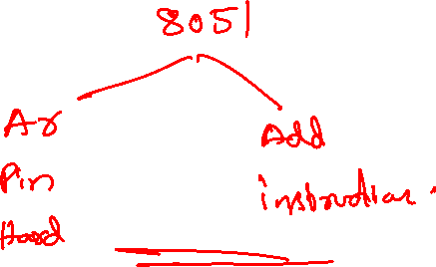
Thank you ☺

